Slide 1
Unit3
IMAGES, COLORS AND BACKGROUND

Slide 2
Common Image Formats
JPEG: - (Joint Photographic Experts Group)
JPEG handles color very well.
Should be preferred format for detailed images.
GIF: -(Graphics Interchange Format)
GIF is alight weight format(256 color).
Allows animated images using frames.
Useful for logos,icons and other low detail images.
PNG: - (Portable Network Graphics)
Another format similar to GIF(256 color).
Can easily be compressed into smaller sizes without any loss in detail.
Best suited for logos,icons, bottons etc.
BMP(BMP File Format)
The BMP file format (Windows bitmap) handles graphic files within the Microsoft Windows OS.
Typically, BMP files are uncompressed, and therefore large and lossless; their advantage is their simple structure and wide acceptance in Windows programs.

Slide 3
How to embed(or Add) images in an html page ?
Use the < img > element to embed your image onto the webpage
The src attribute indicates the location of the image to be embedded .
For eg: src="xyz.png"
"alternate":The alt attribute which stands for "alternate" provides Textual description of the image .
This text is not readable by the user but provides information about the image to search engines line Google, Bing etc.
Image search uses this attribute extensively. Eg: alt="This is my image"

Slide 4
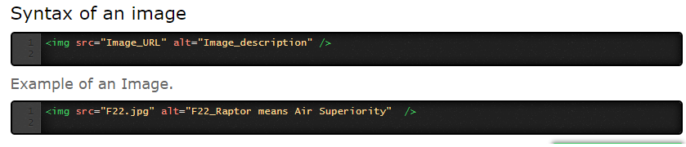

Slide 5
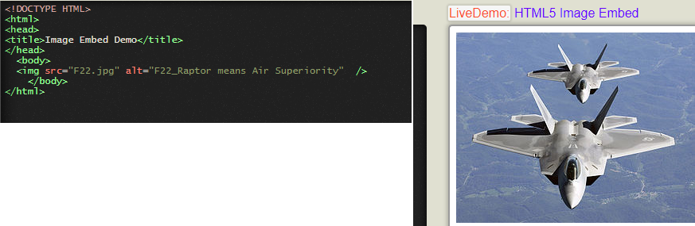
Demo of <img> tag

Slide 6
SCALING OF IMAGES
We can modify the display size of the image by specifying the width and height.
Width: Specifies the width of the image in pixels.
We can also use percentage.For eg: 50%.
Height: Specifies the height of the image.
We can also use percentage. Eg: 30%.

Slide 7
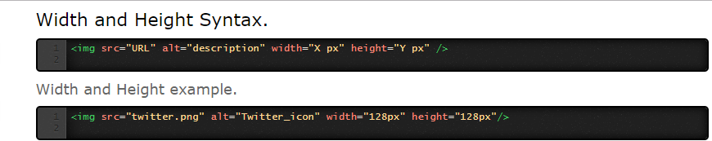

Slide 8
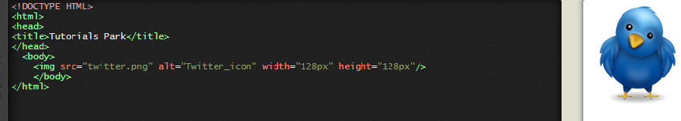

Slide 9
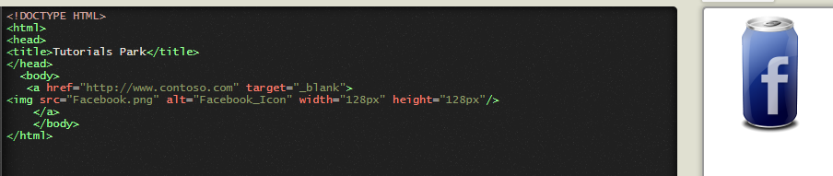
Image as a Link
Image Hyperlink is used to create links between Webpages.
Encapsulate an <img> element between the < a > tag and </a> tag

Slide 10
Image Placement: effects when an Image is placed in between or around text contents
Before a Paragraph: Since paragraph is block level element it starts on a new line
At Start of a Paragraph: The first line align with the graphics, in case image is at the end of a paragraph the last line would align.
In Between a Paragraph: Image appears right in between the contents of the paragraph.

Slide 11
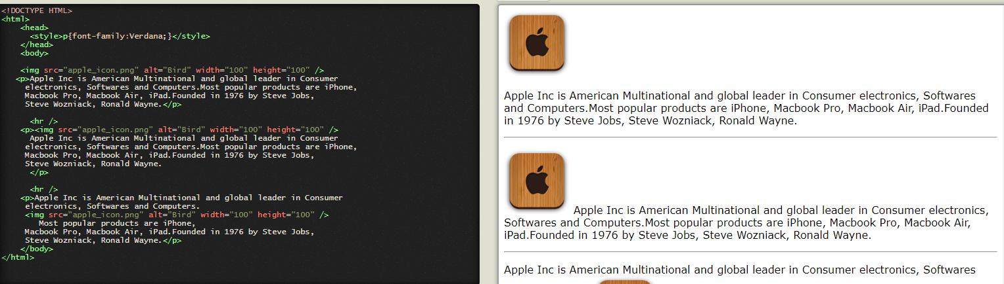
Wrapping image around text

Slide 12
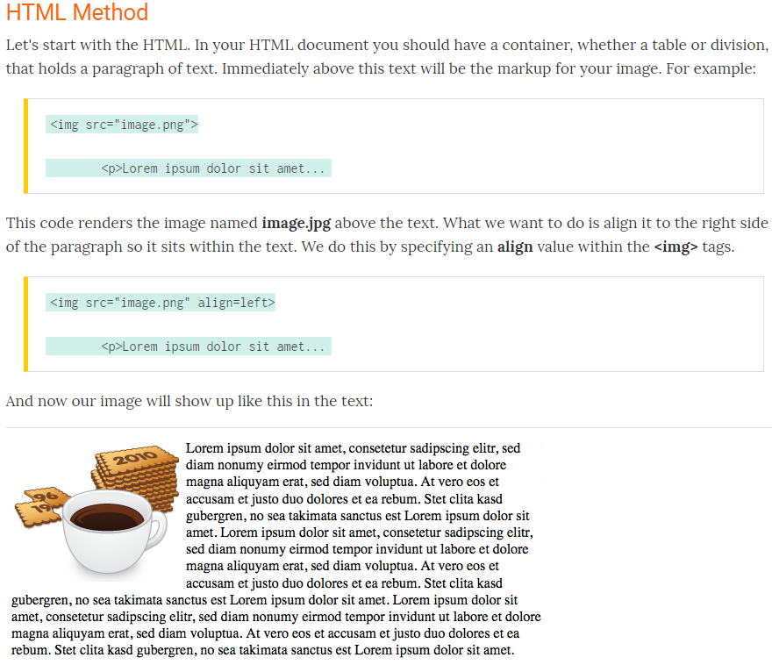
HOW TO WRAP TEXT AROUND AN IMAGE.

Slide 13
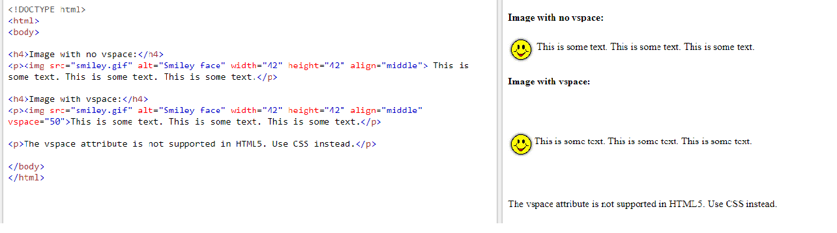
Vspace The vspace attribute specifies the whitespace on top and bottom of an image.

Slide 14
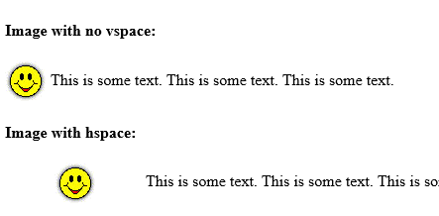
Hspace
The hspace attribute specifies a whitespace margin on the left and right of the image.
<!DOCTYPE html>
<html>
<body>
<h4>Image with no vspace:</h4>
<p><img src="smiley.gif" alt="Smiley face" width="42" height="42" align="middle"> This is some text. This is some text. This is some text.</p>
<h4>Image with hspace:</h4>
<p><img src="smiley.gif" alt="Smiley face" width="42" height="42" align="middle" hspace="50">This is some text. This is some text. This is some text.</p>
<p>The hspace attribute is not supported in HTML5. Use CSS instead.</p>
</body>
</html>

Slide 15
<map> tag
The <map> tag is used to define a client-side image-map. An image-map is an image with clickable areas.
The required name attribute of the <map> element is associated with the <img>'s usemap attribute and creates a relationship between the image and the map.
The <map> element contains a number of <area> elements, that defines the clickable areas in the image map.

Slide 16
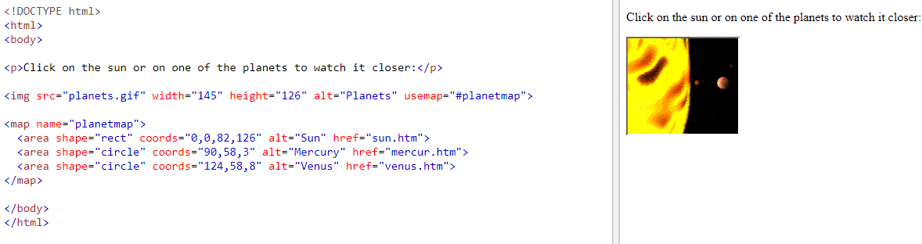
Demo of <map> tag

Slide 17
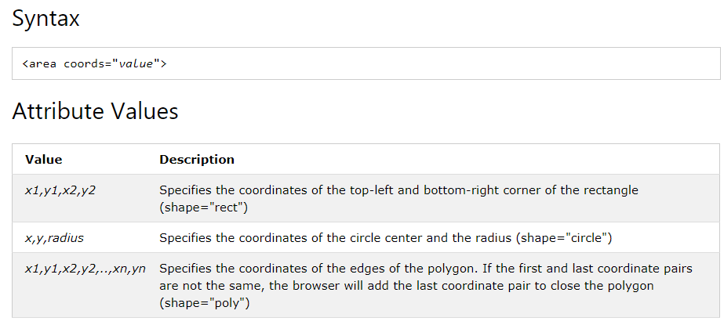
Coords tag

Slide 18
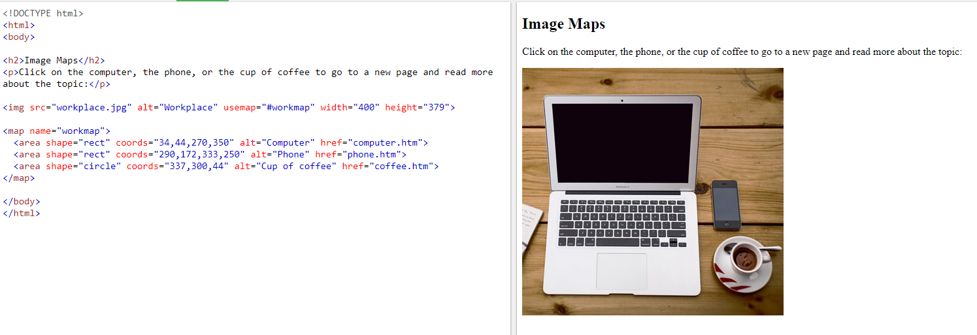
Demo of <map> tag

Slide 19
Background Image
Example
To add a background image on a web page, specify the background-image on the BODY element:

Slide 20
Demo of background image
<html>
<body background="w3s.png">
<h1>Hello world!</h1>
<p>Demo of background image</p>
</body>
</html>

Slide 21
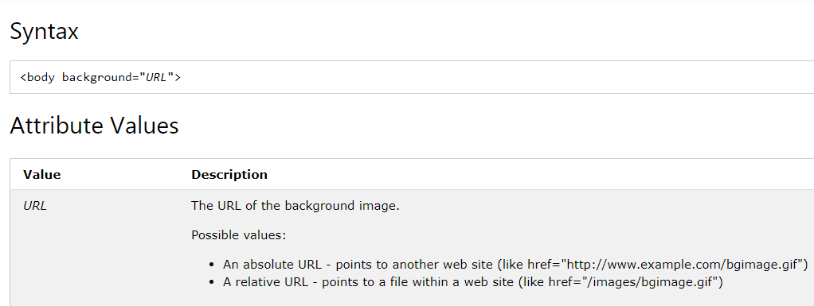

Slide 22
The HTML <picture> Element
HTML5 introduced the <picture> element to add more flexibility when specifying image resources.
The <picture> element contains a number of <source> elements, each referring to different image sources. This way the browser can choose the image that best fits the current view and/or device.
Each <source> element have attributes describing when their image is the most suitable.
The browser will use the first <source> element with matching attribute values, and ignore any following <source> elements.

Slide 23
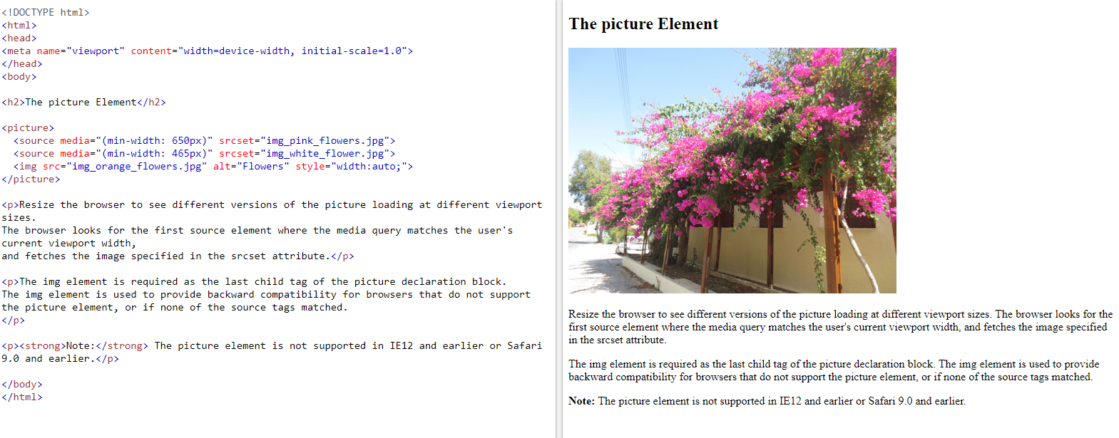
Demo of picture element

Slide 24
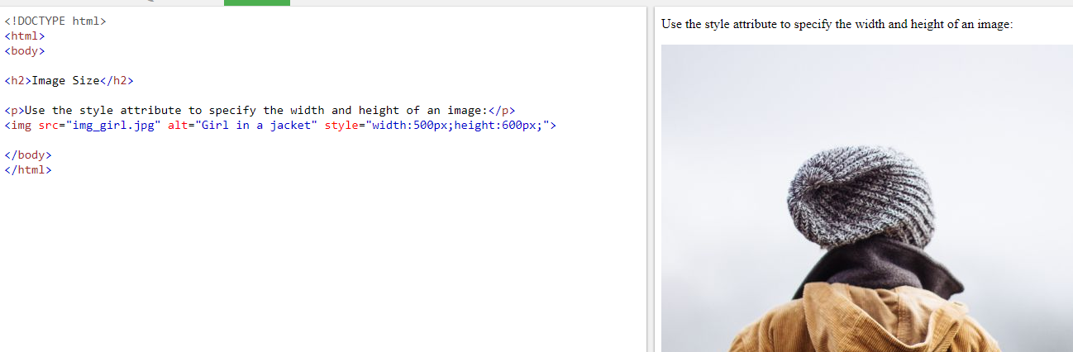
Style attribute of image

Slide 25
Images in Another Folder
If not specified, the browser expects to find the image in the same folder as the web page.
However, it is common to store images in a sub-folder.
We must then include the folder name in the src attribute:

Slide 26
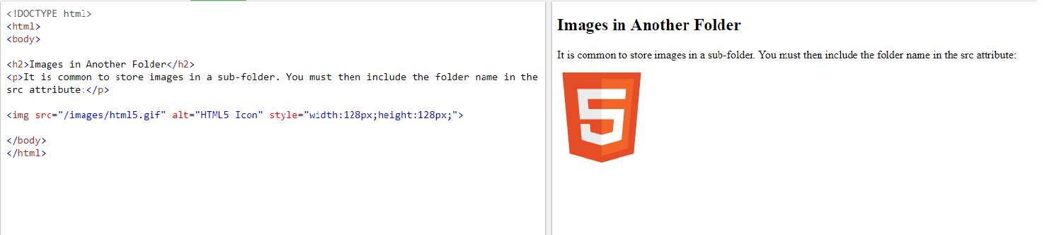

Slide 27
Images on Another Server
Some web sites store their images on image servers.
Actually, you can access images from any web address in the world:

Slide 28
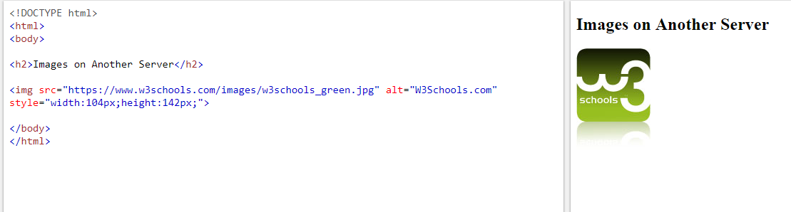

Slide 29
Image as a Link
To use an image as a link, put the <img> tag inside the <a> tag:

Slide 30
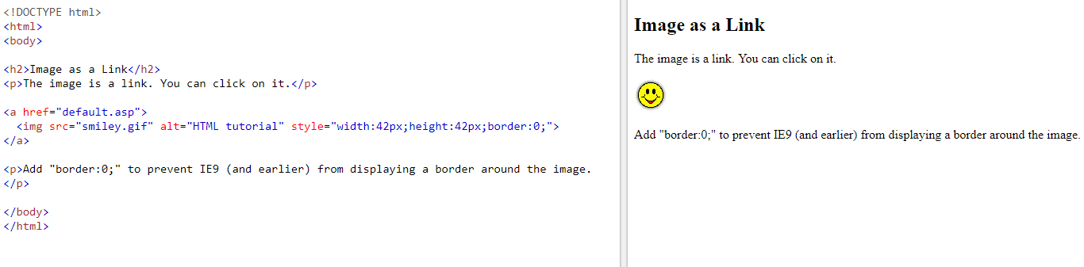

Slide 31
background image on a paragraph
To add a specify the background-image property on the P element:

Slide 32
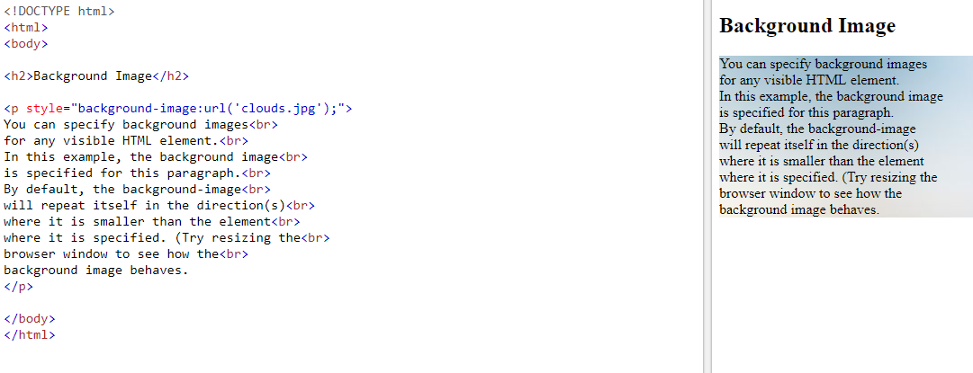

Slide 33
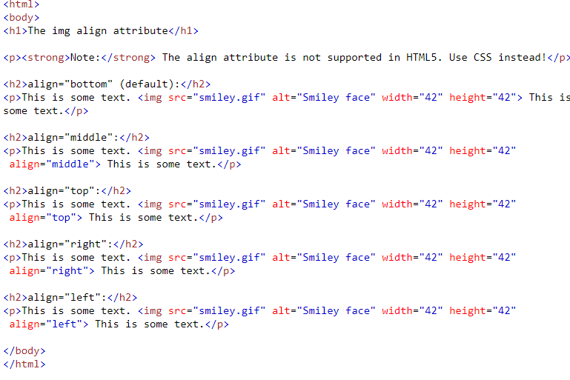
HTML <img> align Attribute

Slide 34
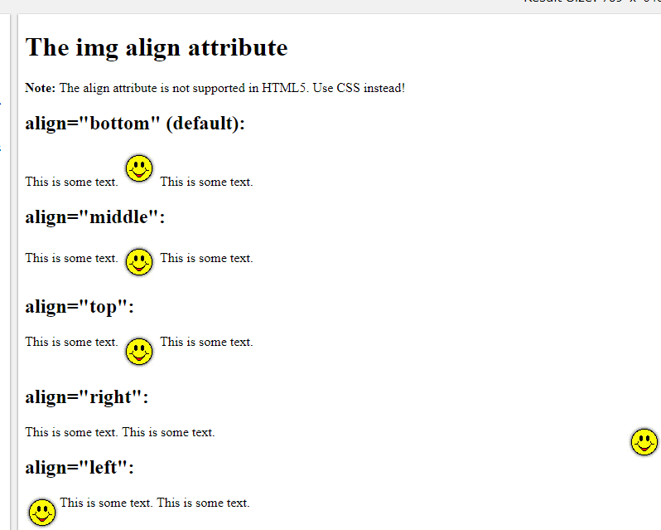

Slide 35
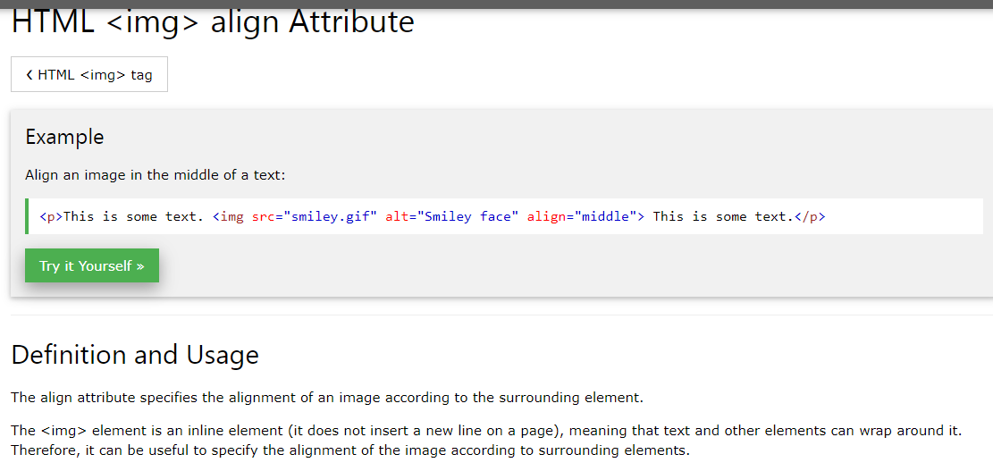

Slide 36
